Slide 1

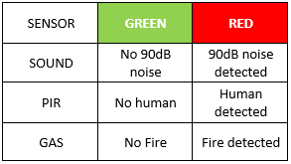
Signal Output Processing
Significant difference
Before and after detection
(α = 0.01)

